Slide 1
The Rady School of Management
MGT 103
Lecture #15
Advertising and Public Relations
Social Media
March 4, 2020

Slide 2
Announcements
Rady Labs…time is running out! Now is the time if you haven’t signed up
CAPE Evaluations – 2% Extra Credit points towards your Final Exam Score! 3% Points for 90% class participation! Thanks for your help! Send your completion screen shots to Dani
Final Lecture Schedule – Wednesday, March 11th will be 5-minute Group Presentation and Final Exam Review only. Not to be missed!
Group Leaders – 3-5 slide summary, you decide how/who should present…think “Shark Tank”

Slide 3
LEARNING OBJECTIVES (LO)- Advertising, Public Relations
Explain the differences between product advertising and institutional advertising and the variations within each.
Describe the steps used to develop, execute, and evaluate an advertising program.
Explain the advantages and disadvantages of alternative advertising media.
Discuss the strengths and weaknesses of consumer-oriented and trade-oriented sales promotions.
Recognize public relations as an important form of communication.

Slide 4
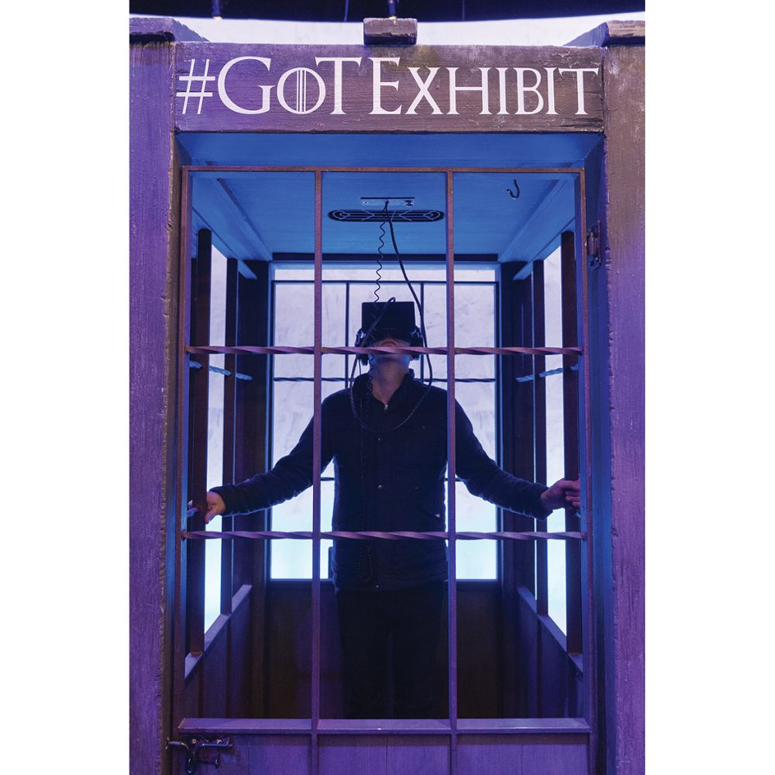

FANTASY IS BECOMING REALITY FOR ADVERTISERS!
More than 20 Million People have Tried VR and AR Technologies
Used for More than Video Games!
VR and AR Offer Unique, Immersive Experiences to Consumers
New Medium for Advertisers
Get Consumers’ Undivided Attention
Virtual Reality
©Ray Tang/REX/Shutterstock

Slide 5
TYPES OF ADVERTISEMENTS PRODUCT ADVERTISEMENTS
Advertising
Product Advertisements
Three Forms:
Pioneering (or Informational)
Competitive (or Persuasive)
Reminder

Slide 6
TYPES OF ADVERTISEMENTS INSTITUTIONAL ADVERTISEMENTS
Institutional Advertisements
Four Forms:
Advocacy
Pioneering Institutional
Competitive Institutional
Reminder Institutional
Chevon Ad

Slide 7
DEVELOPING THE ADVERTISING PROGRAM
Steps in Developing an Ad Program:
Identifying the Target Audience
Specifying the Advertising Objectives
Setting the Advertising Budget
Kia
Super Bowl Ad

Slide 8
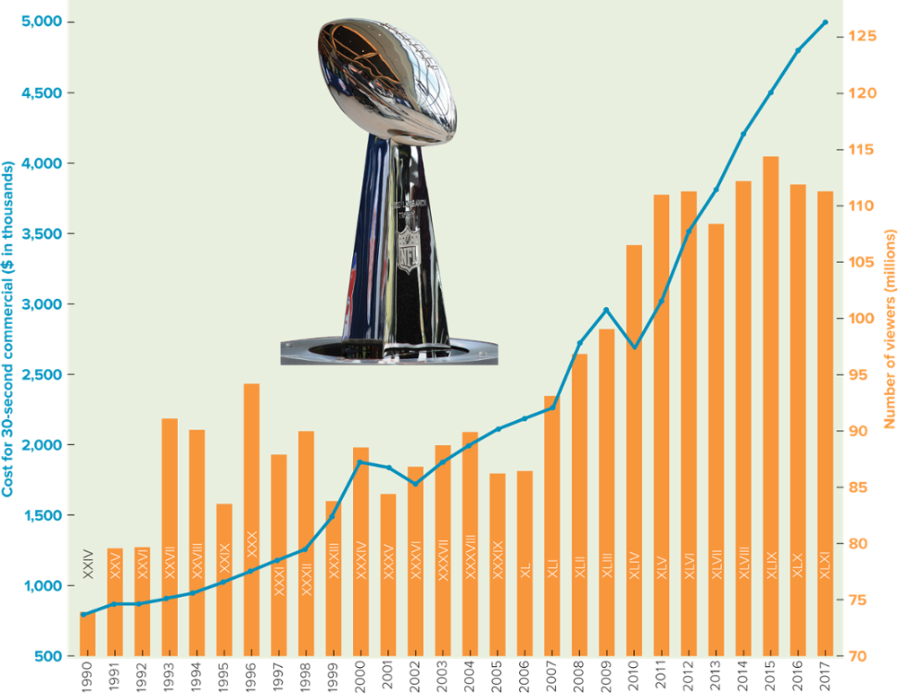
FIGURE 18-1 Super Bowl delivers a huge audience, if you can afford the cost of placing an ad.

Slide 9
MARKETING INSIGHTS ABOUT ME Are You an Expert at Picking the Best Super Bowl Ads?
Super Bowl Is an Exciting Time for Marketers – and Stressful, too!
As You Watch Super Bowl Ads, Evaluate Elements that Create Good Advertising and Select Your Top 10
How do Your Choices Compare with USA Today’s Ad Meter?
Super Bowl
Ad Meter
USA Today

Slide 10
DEVELOPING THE ADVERTISING PROGRAM DESIGNING THE ADVERTISEMENT (1 of 2)
Message Content
Informational Element
Persuasive Element
Common Types of Appeals
Fear Appeals – Avoid Negative Experiences
Sex Appeals – Increase Attractiveness
Humorous Appeals – Fun and Exciting
Geico

Slide 11
DEVELOPING THE ADVERTISING PROGRAM DESIGNING THE ADVERTISEMENT (2 of 2)
Creating the Actual Message
Celebrity Spokespeople
Careful of Image Over Time!
Cost
Ideas and Artwork
Beats by Dre Ad

Slide 12
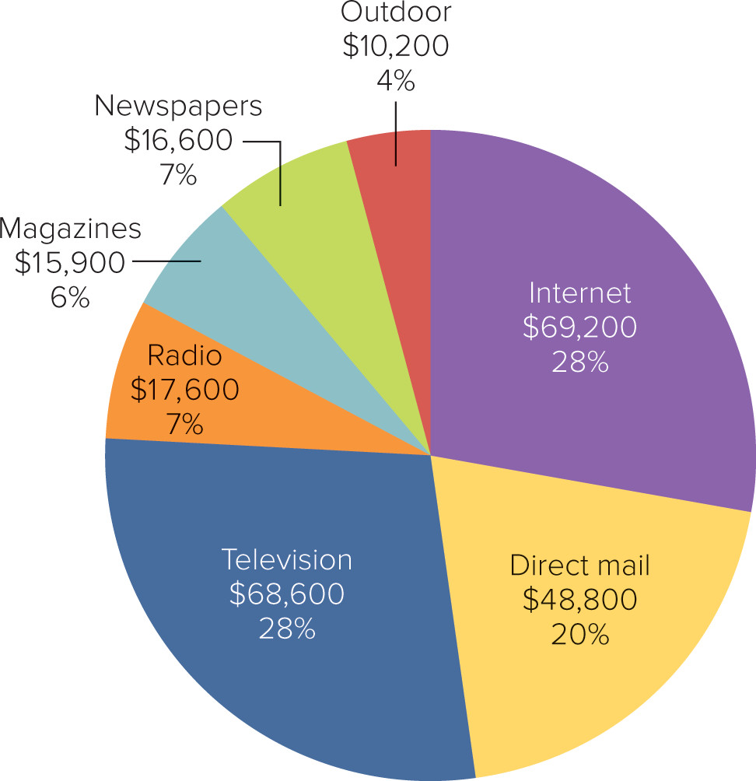
FIGURE 18-2 Television, direct mail, and newspapers account for more than 75% of all advertising expenditures ($ in millions).

Slide 13
APPLYING MARKETING METRICS What Is the Best Way to Reach 1,000 Customers?
Cost per Thousand (CPM) Impressions
CPM = (Cost of Ad ÷ Audience size) x 1,000
Media Alternative | Cost of Ad | Audience Size | Cost per Thousand Impressions
Time (magazine) | $366,000 | 3,000,000 | $122
USA Today (newspaper) | $242,600 | 1,003,529 | $242
Super Bowl (television) | $5,000,000 | 111,000,000 | $45

Slide 14
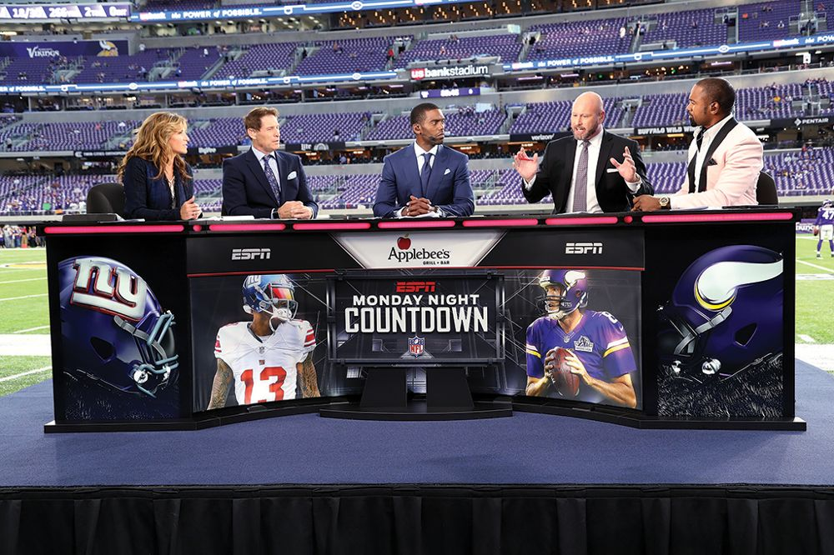
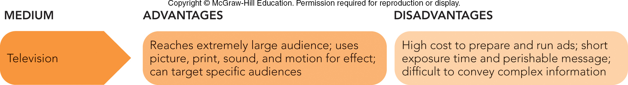
DEVELOPING THE ADVERTISING PROGRAM DIFFERENT MEDIA ALTERNATIVES
Television
Reaches 96 Percent of Households
Out-of-Home TV in Hotels, Bars, Offices, etc.
©Paul Spinelli/AP Images

Slide 15

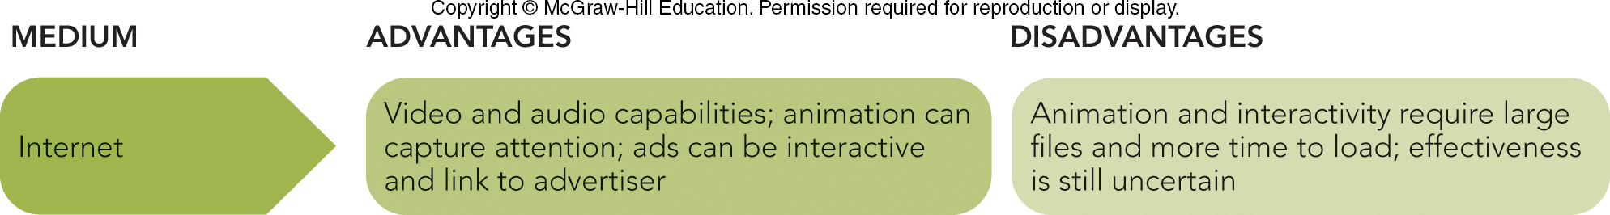
DEVELOPING THE ADVERTISING PROGRAM DIFFERENT MEDIA ALTERNATIVES
Internet and Online Advertising
Audio and Video
Rich Media
Banner/Display Ads
Mobile Marketing
Source: comScore; (tape measure) ©Kim Hall/Getty Images

Slide 16
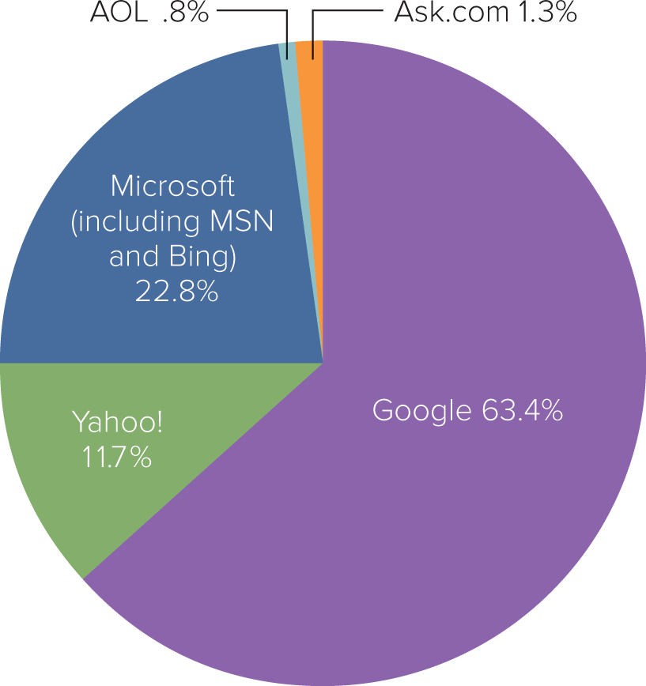
FIGURE 18-4 Google, Microsoft, and Yahoo! have the largest shares of Internet searches and offer opportunities for online advertising

Slide 17
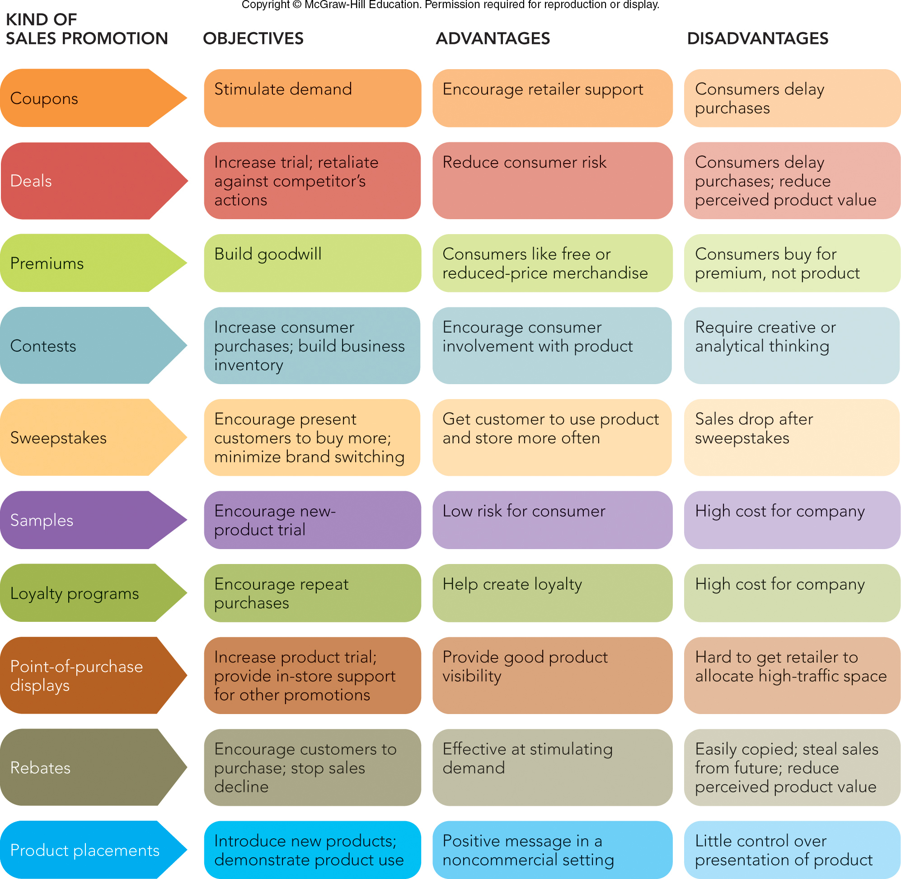
FIGURE 18-6 Sales promotions can be used to achieve many objectives

Slide 18

SALES PROMOTION CONSUMER-ORIENTED SALES PROMOTION
Product Placement
Use of Brand-Name Product in Movie or TV
Annual Value of Product Placements Exceeds $6 Billion
Consumer Complaints are Leading to New Regulations about Disclosure
©Howard Harrison/Alamy Stock Photo

Slide 19
SALES PROMOTION TRADE-ORIENTED SALES PROMOTION (1 of 2)
Trade-Oriented Sales Promotion
Allowances and Discounts
Merchandise Allowance
Case Allowance
Free Goods
Finance Allowance
Floor Stock Protection
Freight Allowance

Slide 20
SALES PROMOTION TRADE-ORIENTED SALES PROMOTION (2 of 2)
Cooperative Advertising
Manufacturer Pays Percentage of Retailer’s Advertising Expense
Training of Distributors’ Salesforces
Success Rests on Resellers’ Salesforce
Produce Manuals, Brochures
National Sales Meetings
Recognition Programs

Slide 21
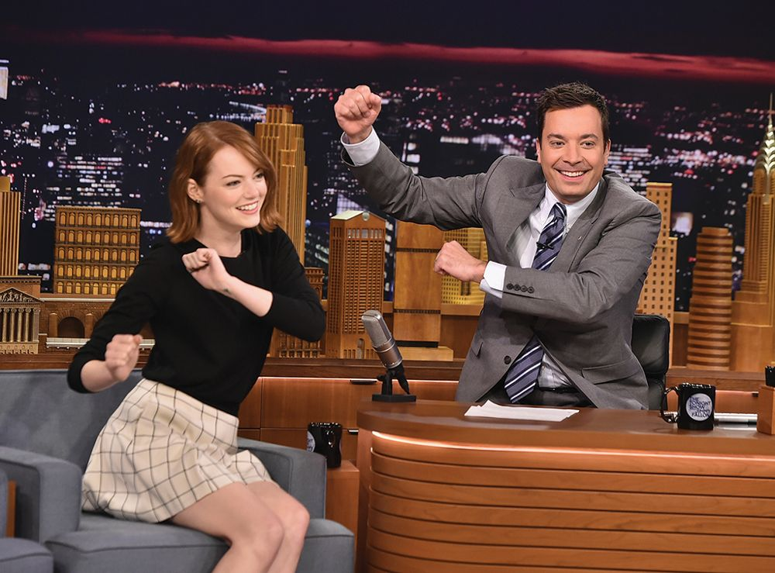
PUBLIC RELATIONS
Publicity Tools
News Release
News Conference
Public Service Announcement (PSA)
Publicity Often Provides Stronger Impact than Does Advertising!
©Theo Wargo/NBC/Stringer/Getty Images
American
Red Cross PSA

Slide 22
The Rady School of Management
MGT 103 Lecture #15
Social Media Channels

Slide 23
LEARNING OBJECTIVES (LO)- Social Media
Define social media and describe how they differ from traditional advertising media.
Identify the four major social media and describe how brand managers integrate them into marketing actions.
Describe the differing roles of those receiving messages through traditional versus social media and how brand managers select social media.
Compare the performance measures of social media linked to costs (inputs) versus revenues (outputs).

Slide 24
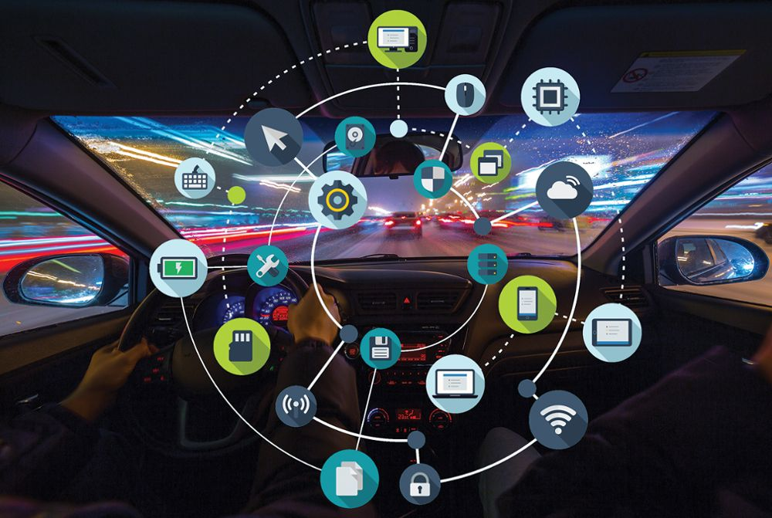
MOBILE MOMENTS WILL SOON INCLUDE A NICE RIDE!
Consumers Experience 150 to 200 “Mobile Moments” Each Day (Example: Social Media)
Now, Connected Cars
Mobile Apps for Special Advertising
61% of Internet Advertising Targets Mobile Devices
Messaging Combined with Internet Bots are “Conversational Commerce”
©Pozdeyev Vitaly/Shutterstock; ©Hilch/Shutterstock

Slide 25
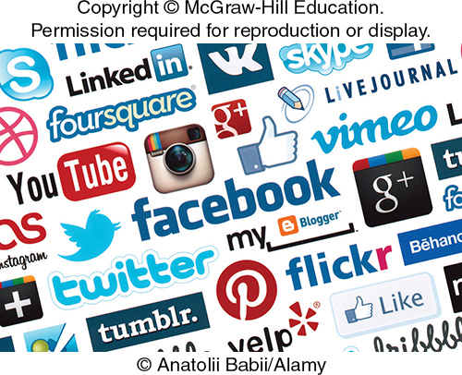
UNDERSTANDING SOCIAL MEDIA WHAT ARE SOCIAL MEDIA? (2 of 2)
Classifying Social Media:
Media Richness
Acoustic, Visual, Personal Contact
Self-Disclosure
Achieve Favorable Image
Greater Self-Disclosure Likely to Increase Influence

Slide 26
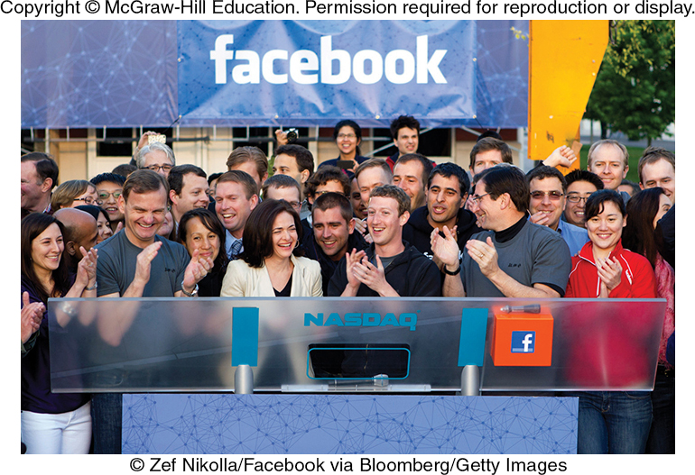
FOUR IMPORTANT SOCIAL NETWORKS FACEBOOK (1 of 2)
Facebook
Facebook in a Brand Manager’s Strategy
Be Creative: Use Links, Photos, Videos
Make It Familiar, But with a Twist
Keep It Fresh
Learn Users’ Passions and Let Them Guide Content
©Zef Nikolla/Facebook via Bloomberg/Getty Images

Slide 27
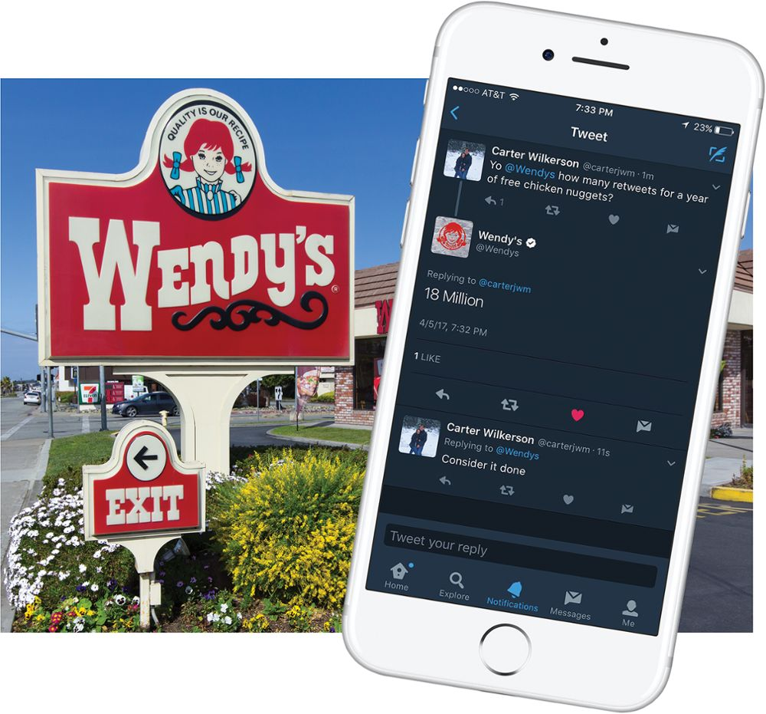

FOUR IMPORTANT SOCIAL NETWORKS TWITTER
Twitter
Twitter in a Brand Manager’s Strategy
Connect in Real Time
Interactive and Live Video
Generate Brand Buzz
Follow the Twitter Profiles
Wendy’s Twitter
©Ken Wolter/Shutterstock; Source: Twitter

Slide 28
FOUR IMPORTANT SOCIAL NETWORKS LINKEDIN (1 of 2)
LinkedIn
LinkedIn in a Brand Manager's Strategy
Building B2B Image
Networking with Industry-Related Groups and Professionals
Identifying Sales Leads and Locating Vendors
Direct Advertising at Specific Companies and People

Slide 29
FOUR IMPORTANT SOCIAL NETWORKS LINKEDIN (2 of 2)
LinkedIn in a College Senior’s Job Search
Write Informative, Short Headline
Include Professional Photo
Create Professional Summary
Fill the Skills and Expertise Section
Include Recommendations
Set Profile to Public and Create URL

Slide 30
FOUR IMPORTANT SOCIAL NETWORKS YOUTUBE
YouTube
YouTube in a Brand Manager’s Strategy
Exploit Visual Aspects of Your Message
Create a Brand Channel with Key Words
Use YouTube Analytics to Target Viewers

Slide 31
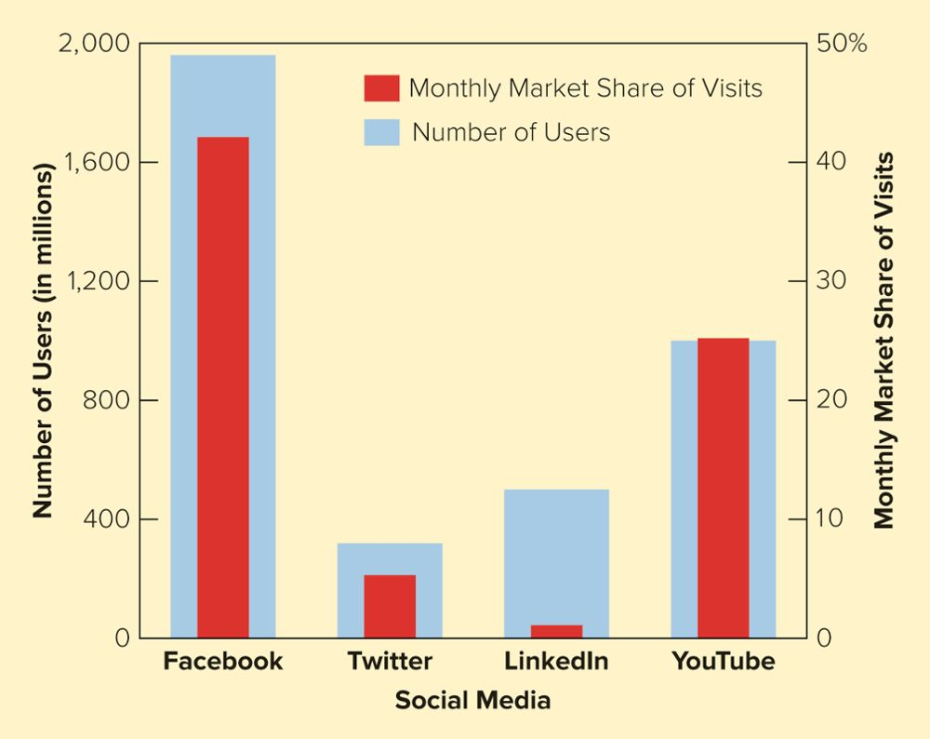
FIGURE 19-4 The number of users and unique visitors for four social network sites: YouTube, Facebook, Twitter, and LinkedIn

Slide 32
Monday March 9th Assignment
Read Chapters #20, 21
Continue work on your Group Marketing Plan
Team Project Work assignment is due on Wednesday, March 11th
Group Leaders come to see me if you have questions/challenges!

Slide 33
The Rady School of Management
MGT 103
Lecture #15
Advertising and Public Relations
Social Media
March 4, 2020

